Slide 1
Bounded Suboptimal Search for CBS
Jiaoyang Li
June 16, 2020

Slide 2
Node selection in the high and low levels of CBS
High-level: A* on the constraint tree
Expands the node with the smallest f value (= sum of path costs + h)
Breaks ties by preferring the node with the smallest number of collisions.
Low-level: A* on the time-extended graph
Expands the node with the smallest f value (= path cost + h)
Breaks ties by preferring the node with the smallest number of collisions with other agents.
Finds an optimal solution

Slide 3
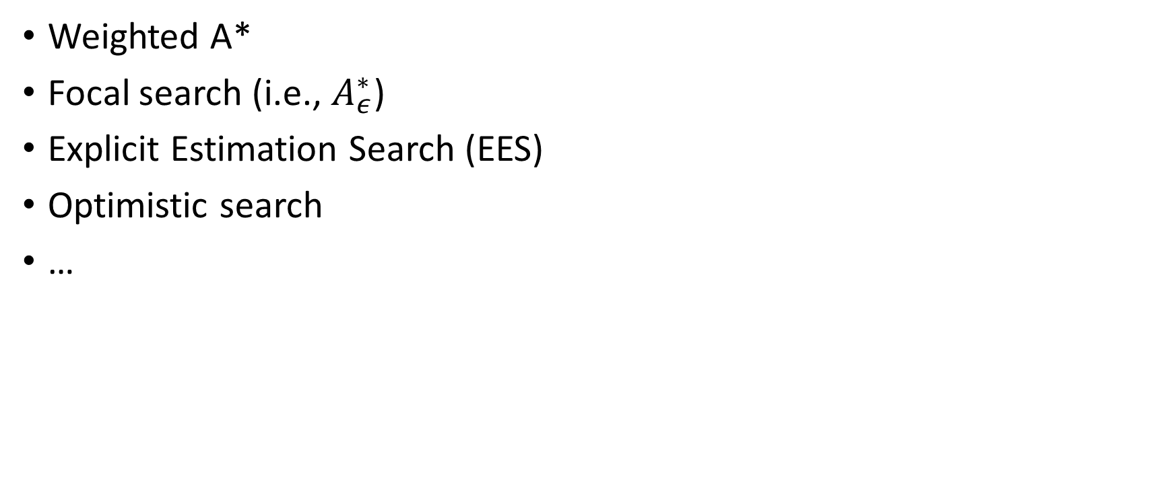
Bounded-suboptimal search algorithms

Slide 4

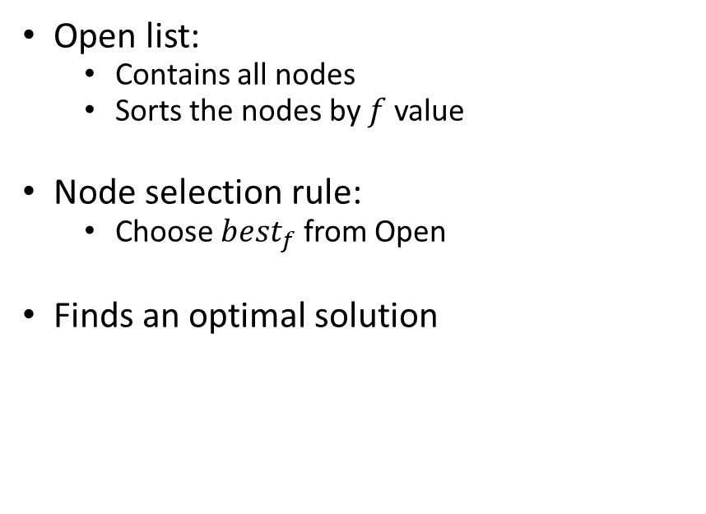
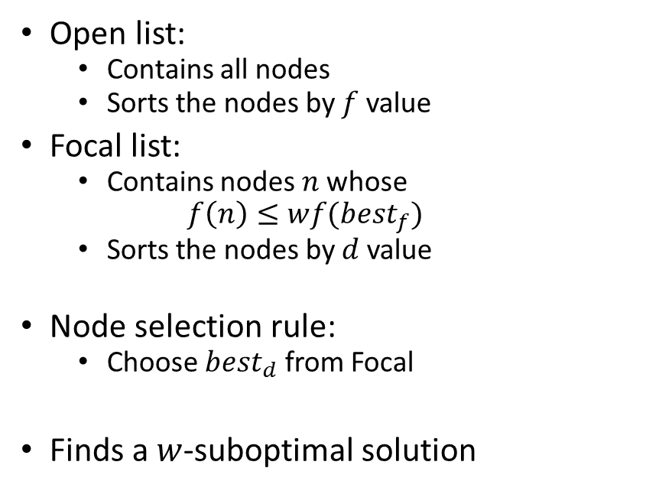
A* vs Focal Search
A*

Slide 5
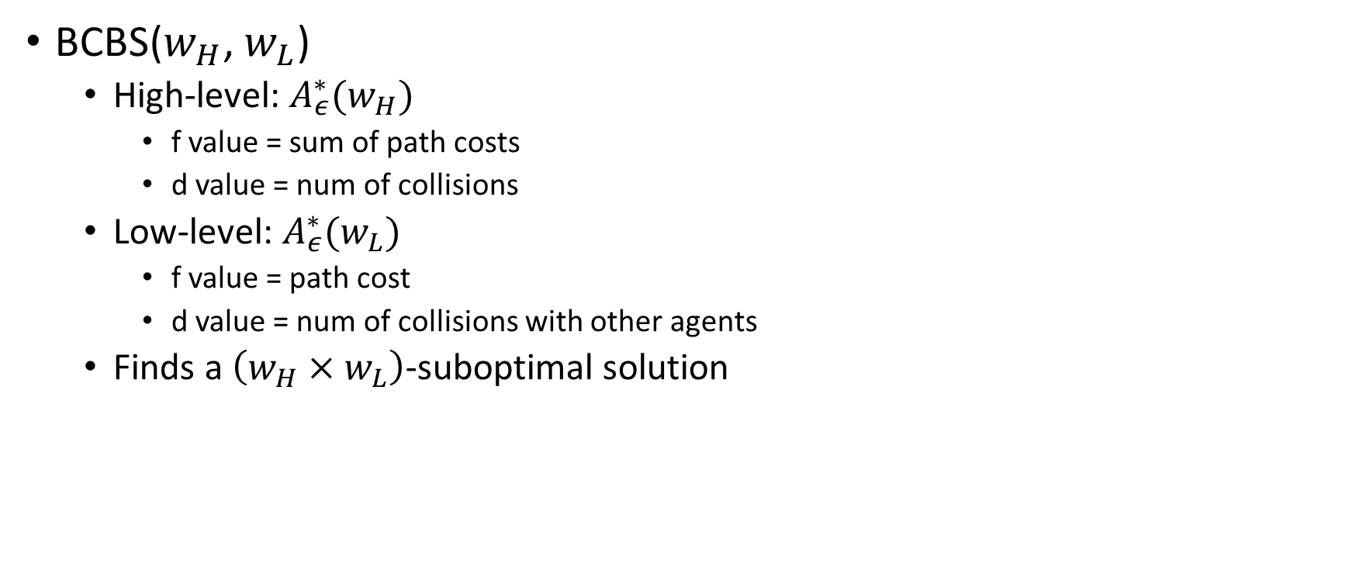
Applying Focal Search to CBS

Slide 6
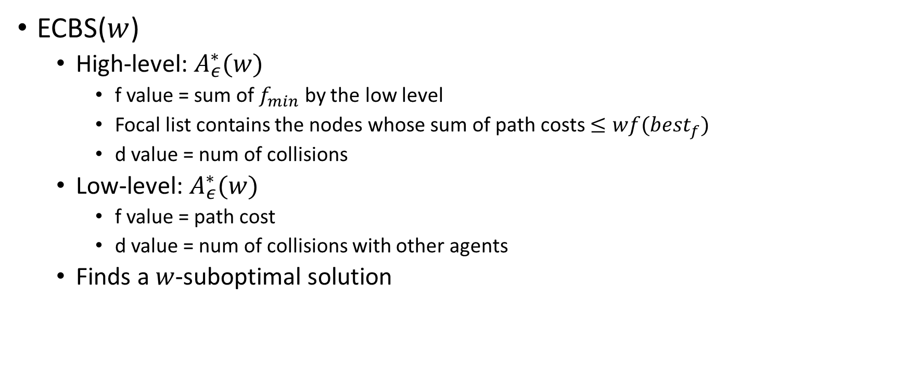
Applying Focal Search to CBS

Slide 7
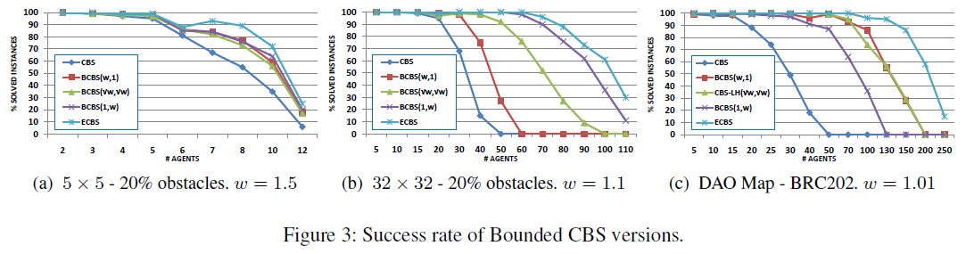
Applying Focal Search to CBS
Results in the ECBS paper
ECBS is the state-of-the-art bounded suboptimal solver for MAPF.

Slide 8
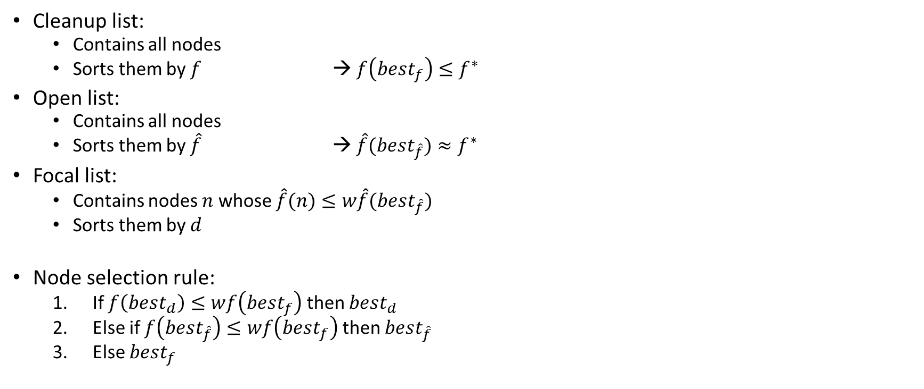
Explicit Estimation Search (EES)

Slide 9

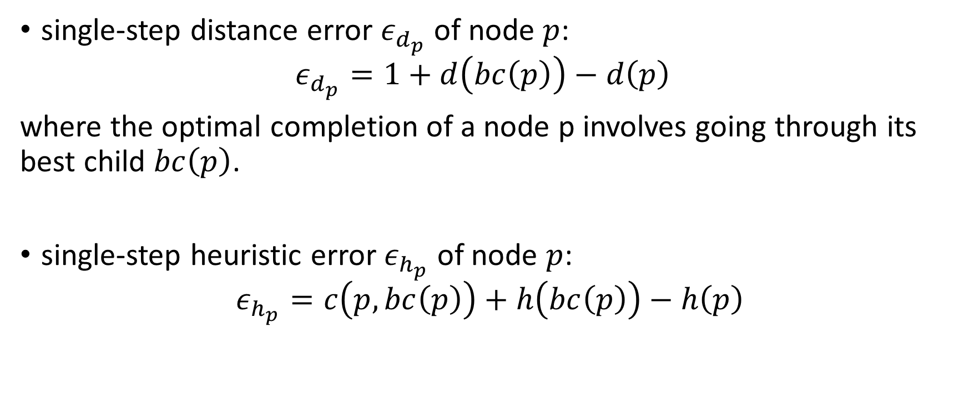

Slide 10
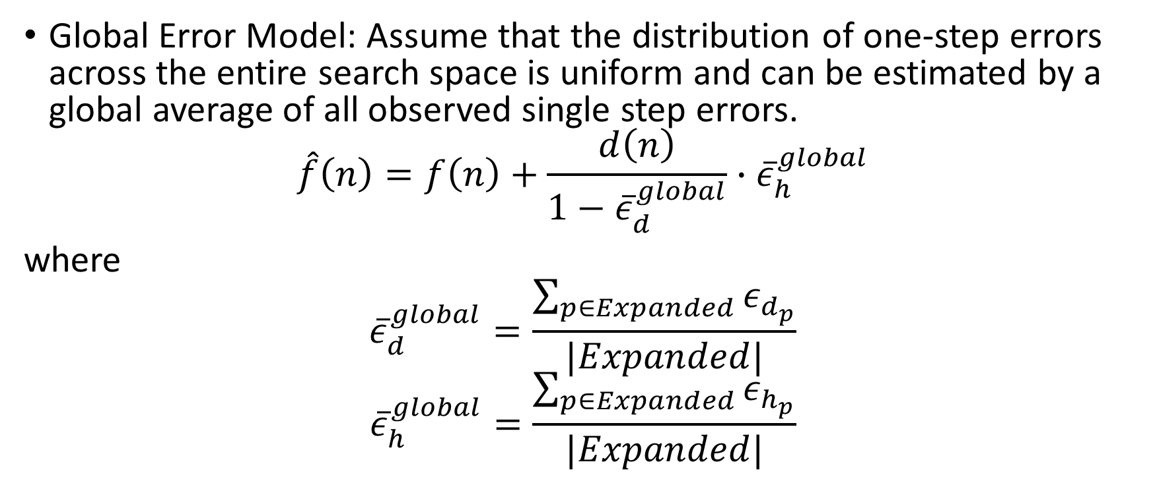

Slide 11
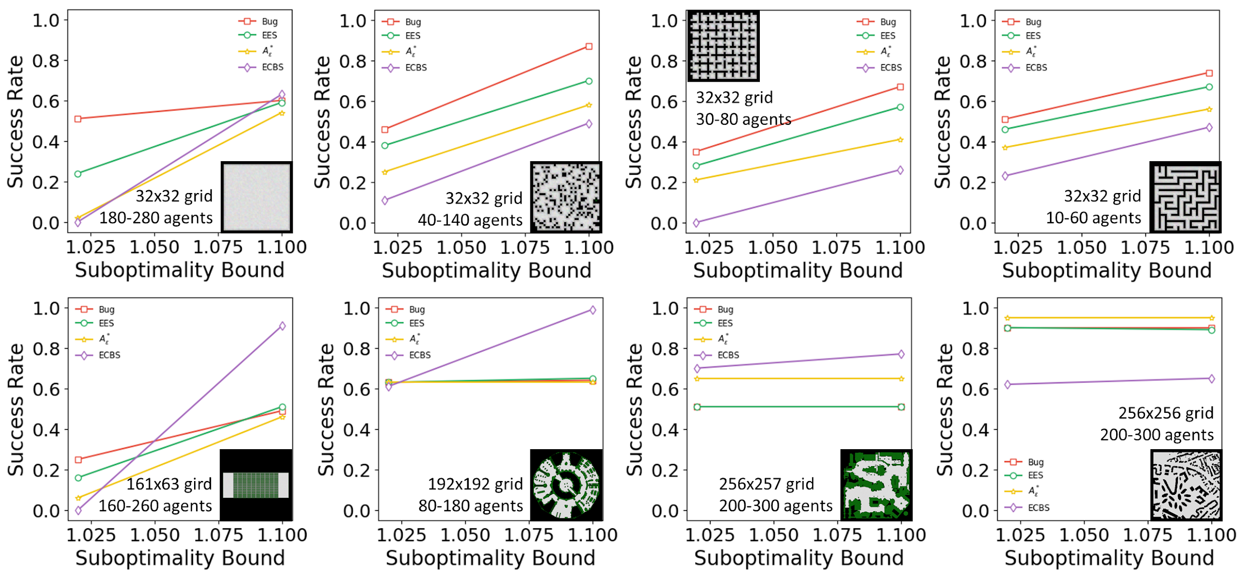
Applying EES to CBS (ongoing work with Wheeler Ruml)

Slide 12
Optimistic search
Step 1: running an aggressive algorithm to find an incumbent.
Any fast search method with an open list can be used.
Step 2: expanding additional nodes until we can either prove our solution is w-suboptimal or we find a better one.
The method depends heavily on the aggressive search finding a node which falls within the desired suboptimality bound.

